Slide 1
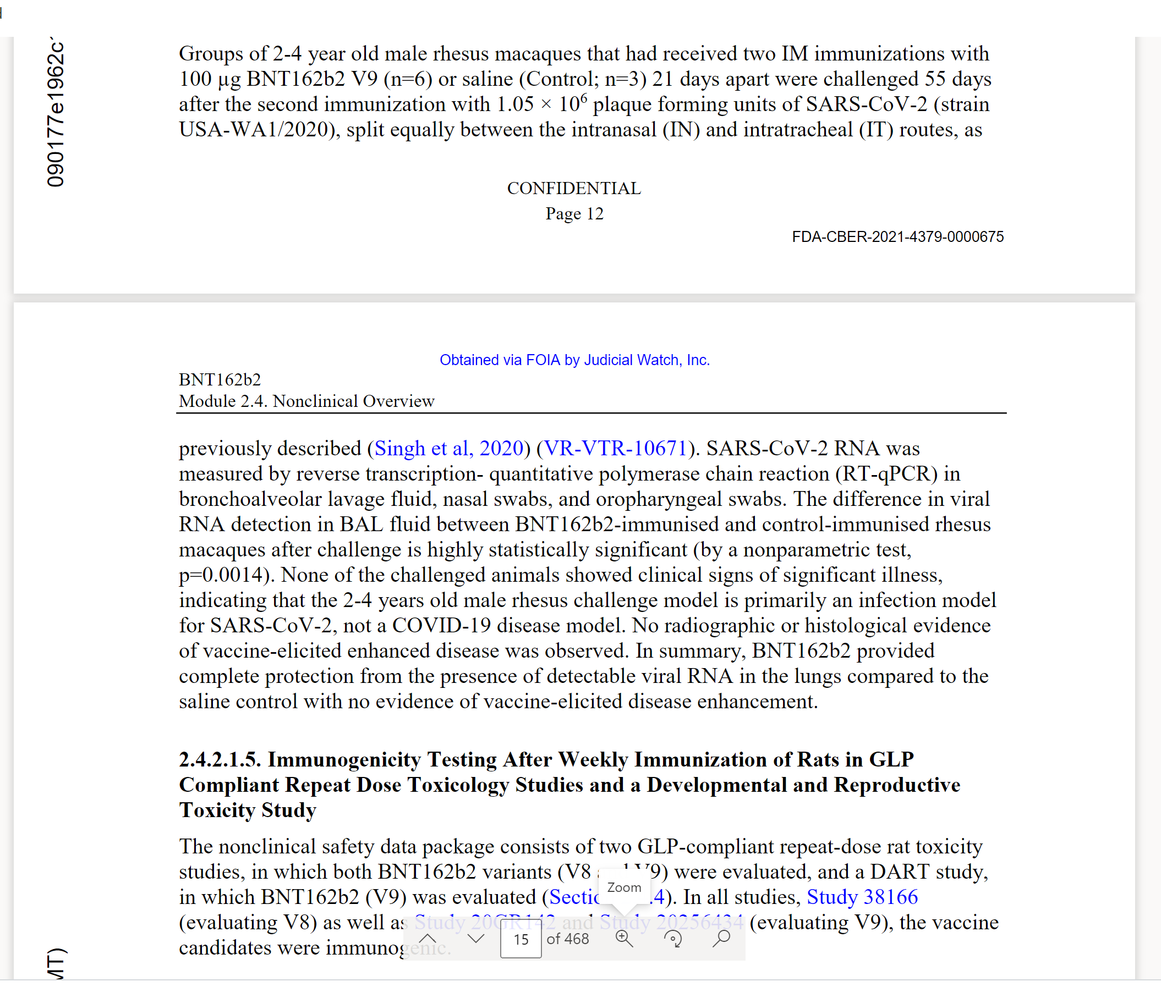
Pfizer chose the animal model that does not develop covid illness from Sars-Cov-2 even when it’s sprayed in their noses and throats. The monkeys had viral RNA load but no covid-19 illness, neither in immunized nor in placebo control groups. Pfizer made the conclusion that the immunization is successful/confers protection and there is no ADE. Science!

Slide 2
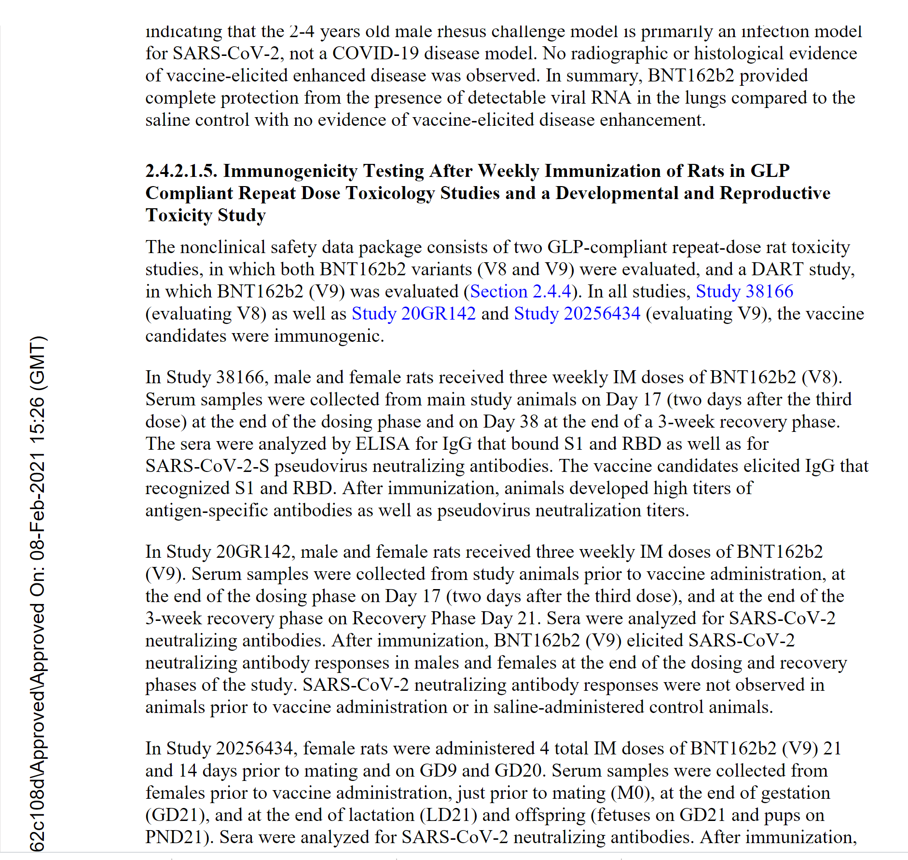
What are the differences between V8 and V9?
We later learn that none are the same as the ultimately licensed product (see p. 9 of this document).

Slide 3
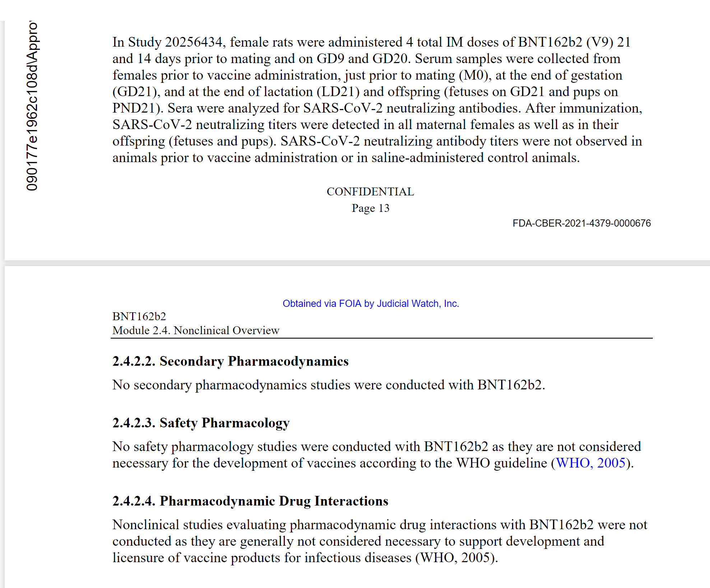
mRNA injections do not meet the WHO 2005 definition of the vaccine, and therefore WHO guidelines for vaccines from 2005 are irrelevant.

Slide 4
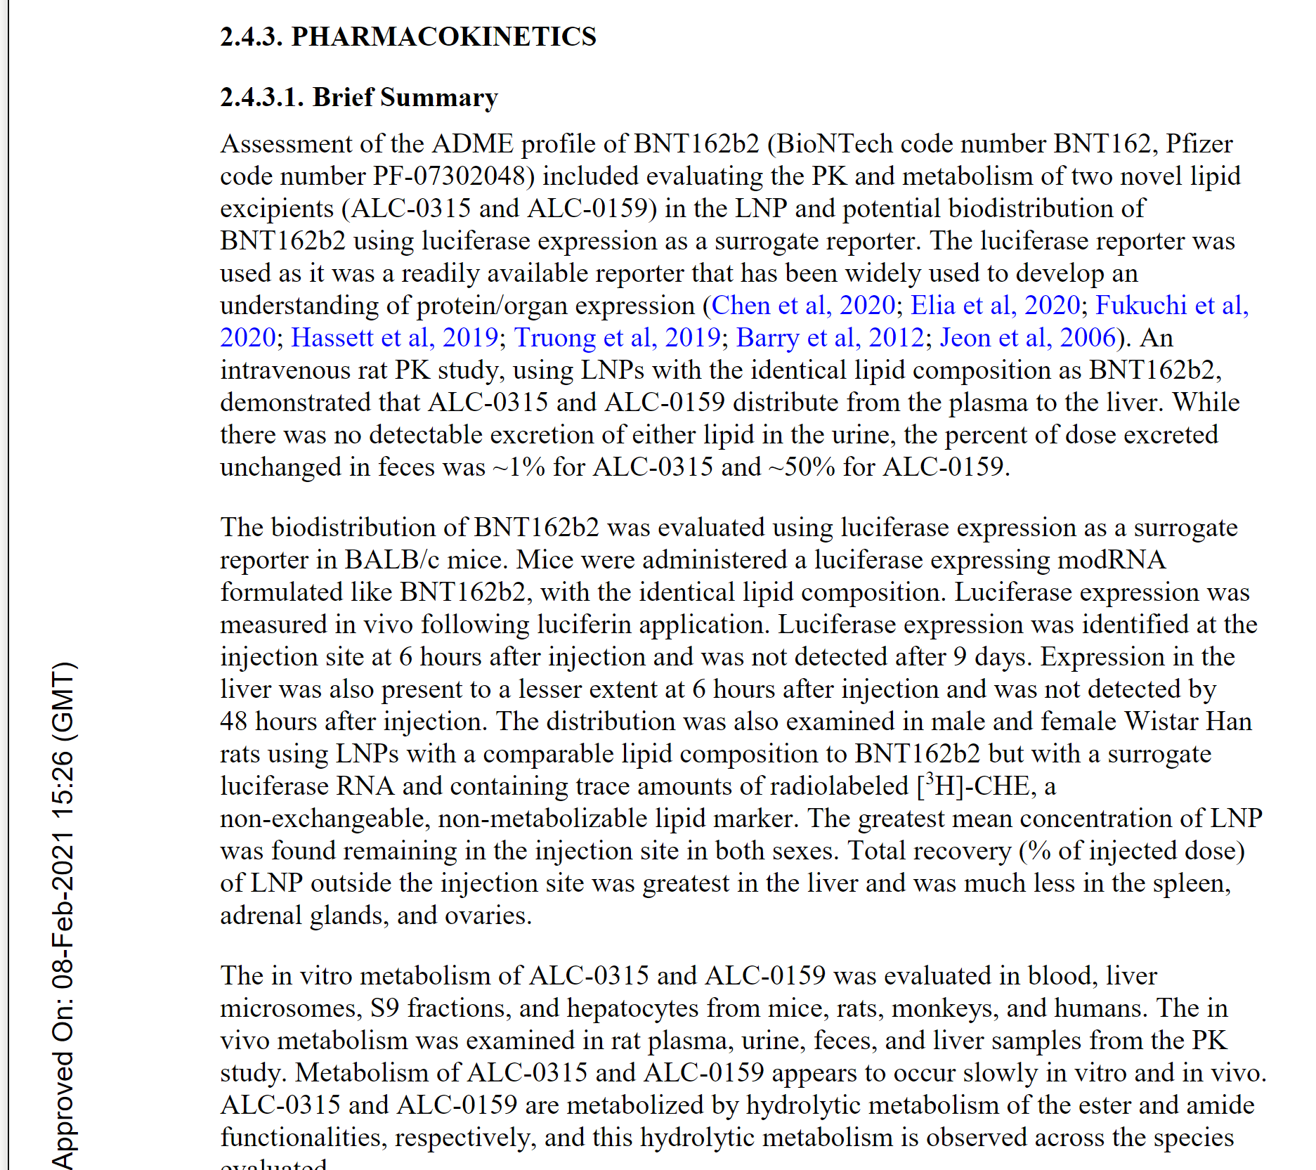
Pfizer, CDC and FDA lied repeatedly about “vaccine staying in the injection site”. The substance is clearly getting distributed into the liver, spleen, ovaries and other organs. Yet, no safety pharmacology or drug-drug interactions studies were done and therefore we have no knowledge of the safety margins! E.g. liver is a primary site for observing safety issues: compromise of the liver as a metabolizing organ for drugs with resulting drug-drug interactions and, also direct hepatic cytotoxicity.

Slide 5
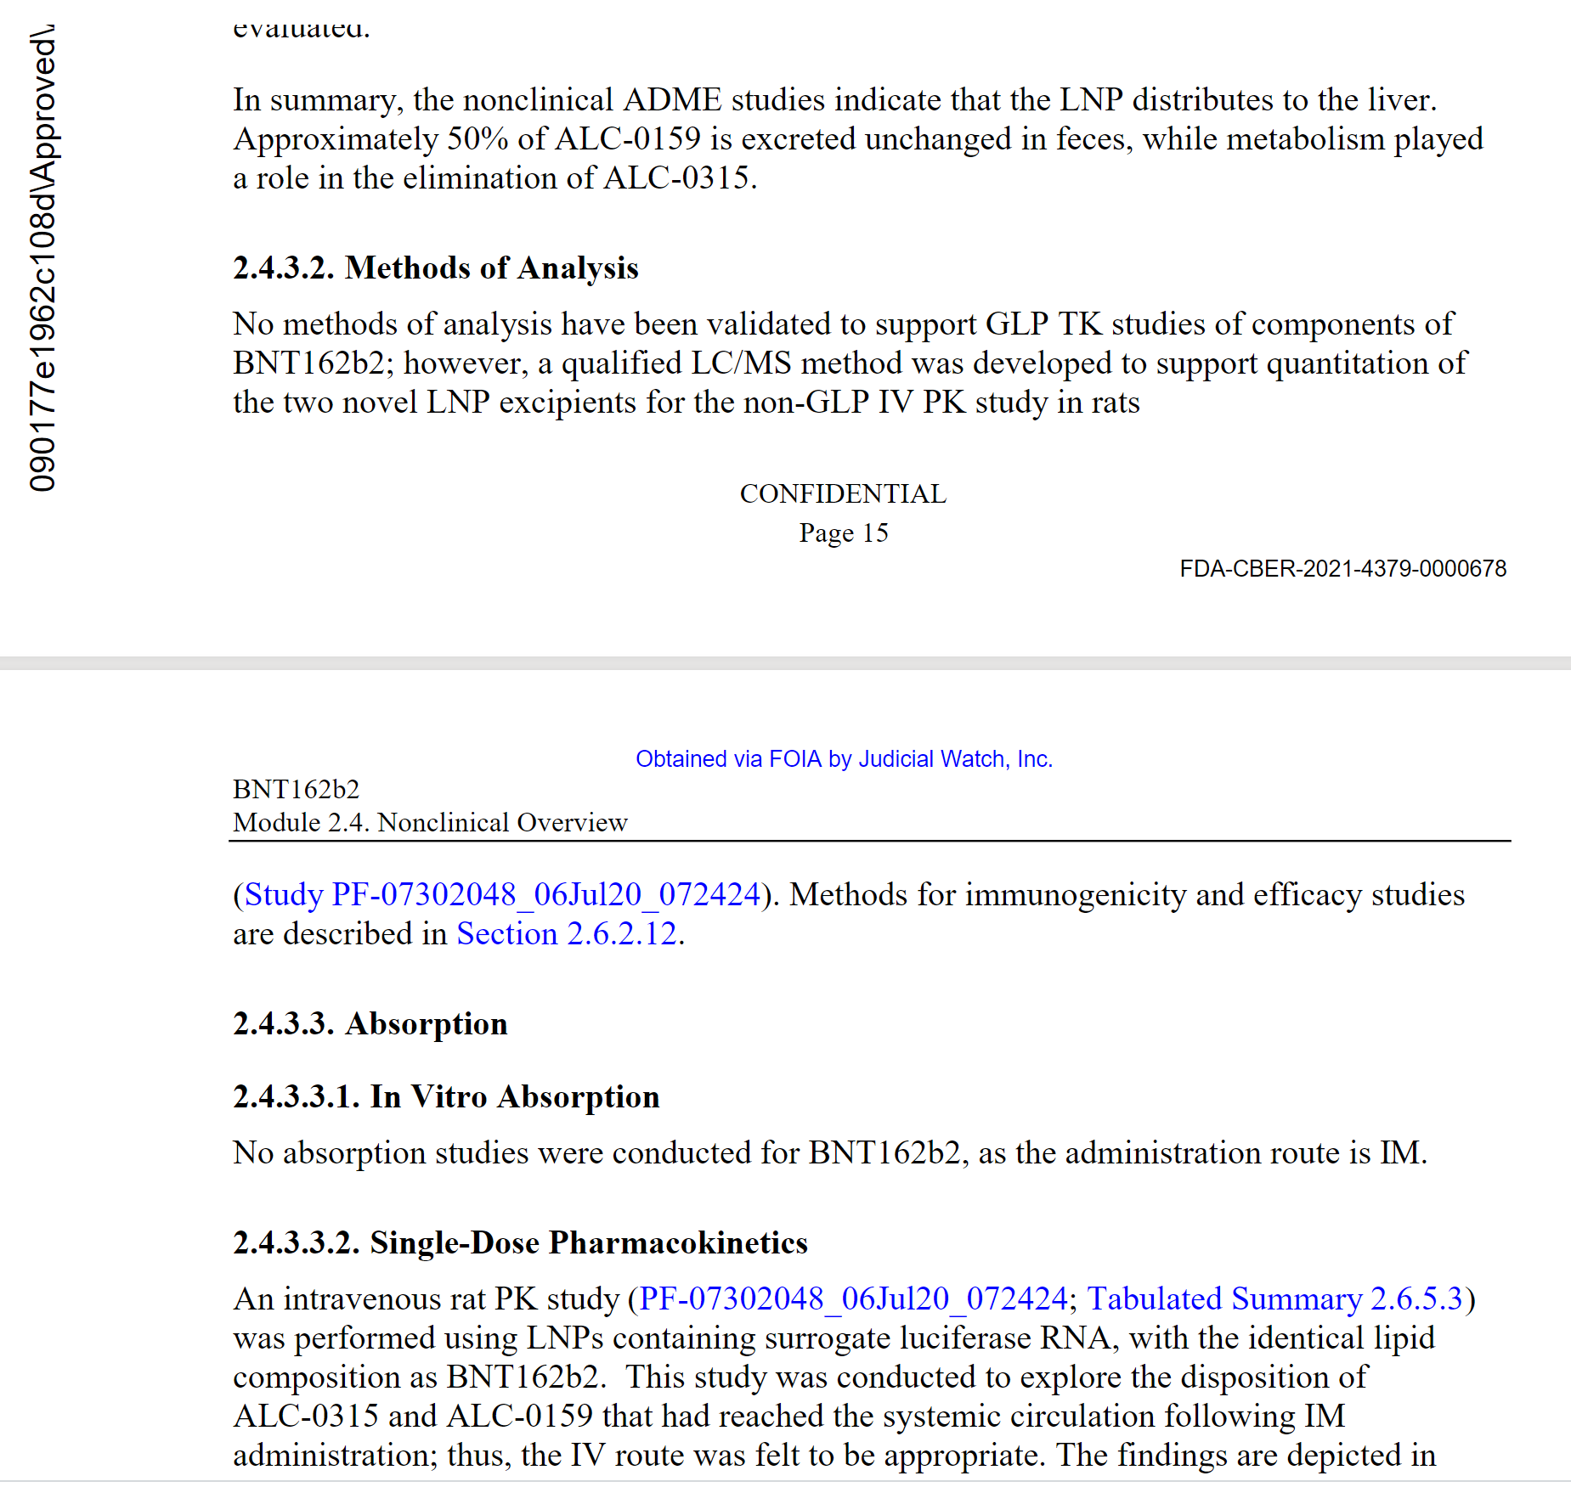
No GLP methods of analysis for toxicokinetic studies of the completely novel components of BNT! This means we cannot ever be certain of what those components are, how to detect them, in what quantities they appear, what metabolites they produce, etc. etc. “Qualified LC/MS method” is a fancy way of describing a non-validated non-GLP method – a “quick and dirty” methodology that is acceptable only for early feasibility studies. The non-GLP studies of completely novel excipients are not acceptable by FDA guidelines in general, even for Phase II/III studies, much less for approval. This is an example of FDA ignoring its own guidelines.

Slide 6
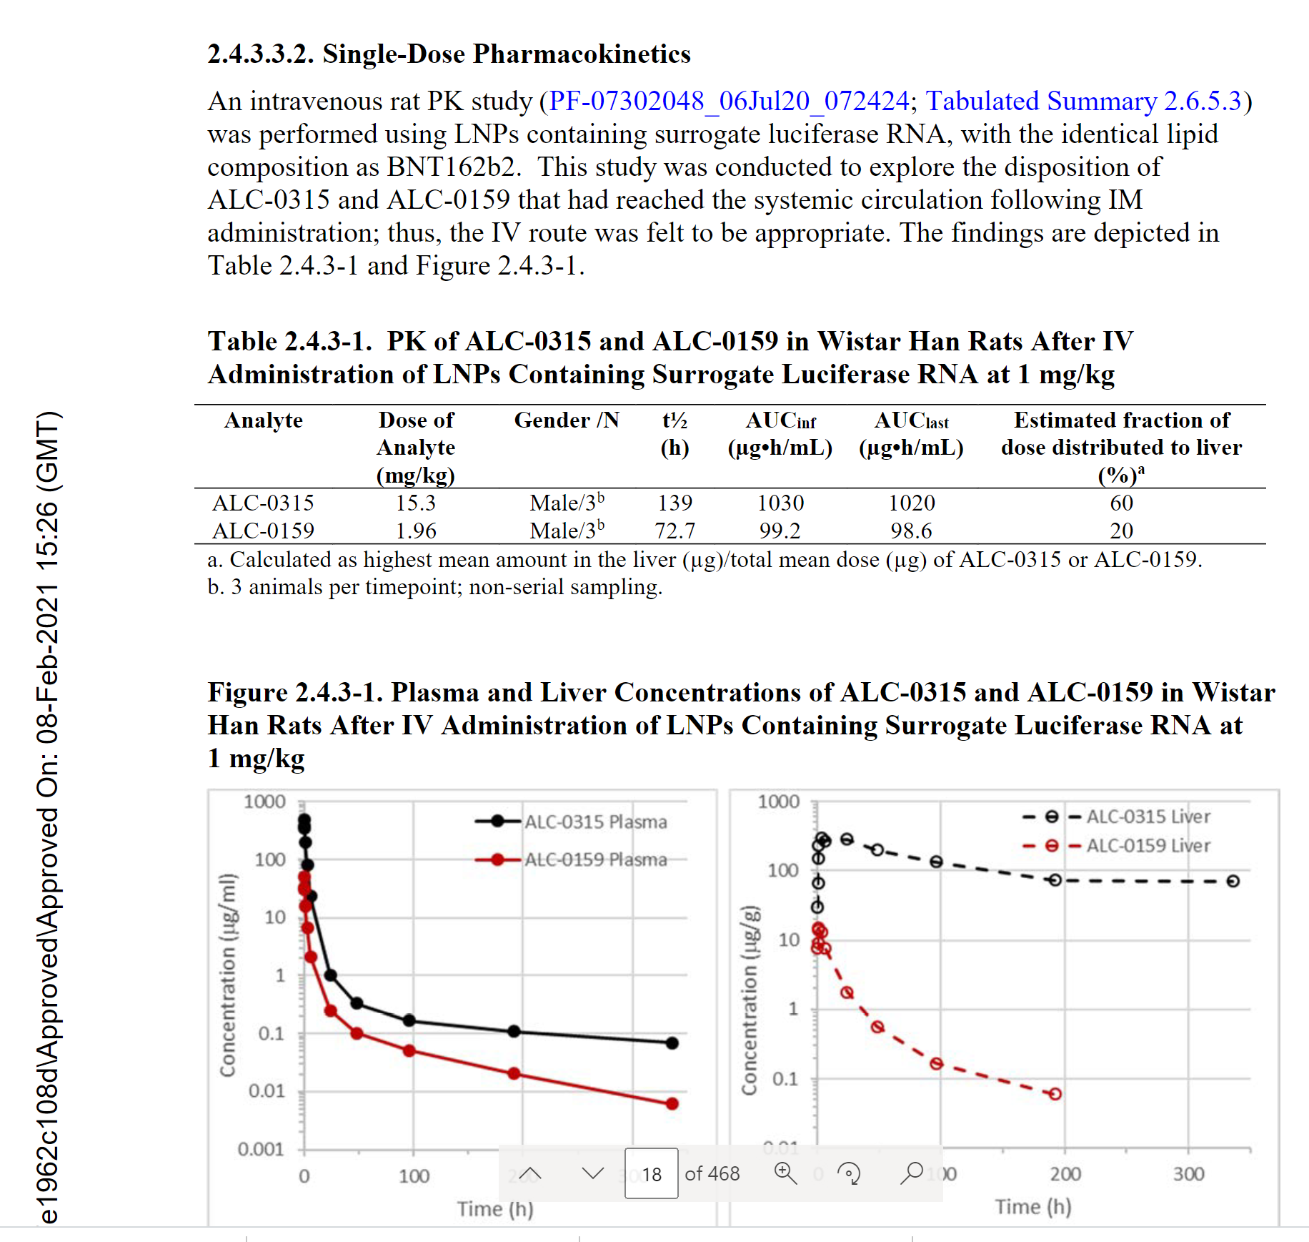
Pfizer was expecting the injections to be reaching blood stream directly. CDC specifically issued recommendation to providers to NOT aspirate the needle, increasing the probability of this.
The excipients are getting to the liver in large quantities, yet we have no safety pharmacology studies!

Slide 7
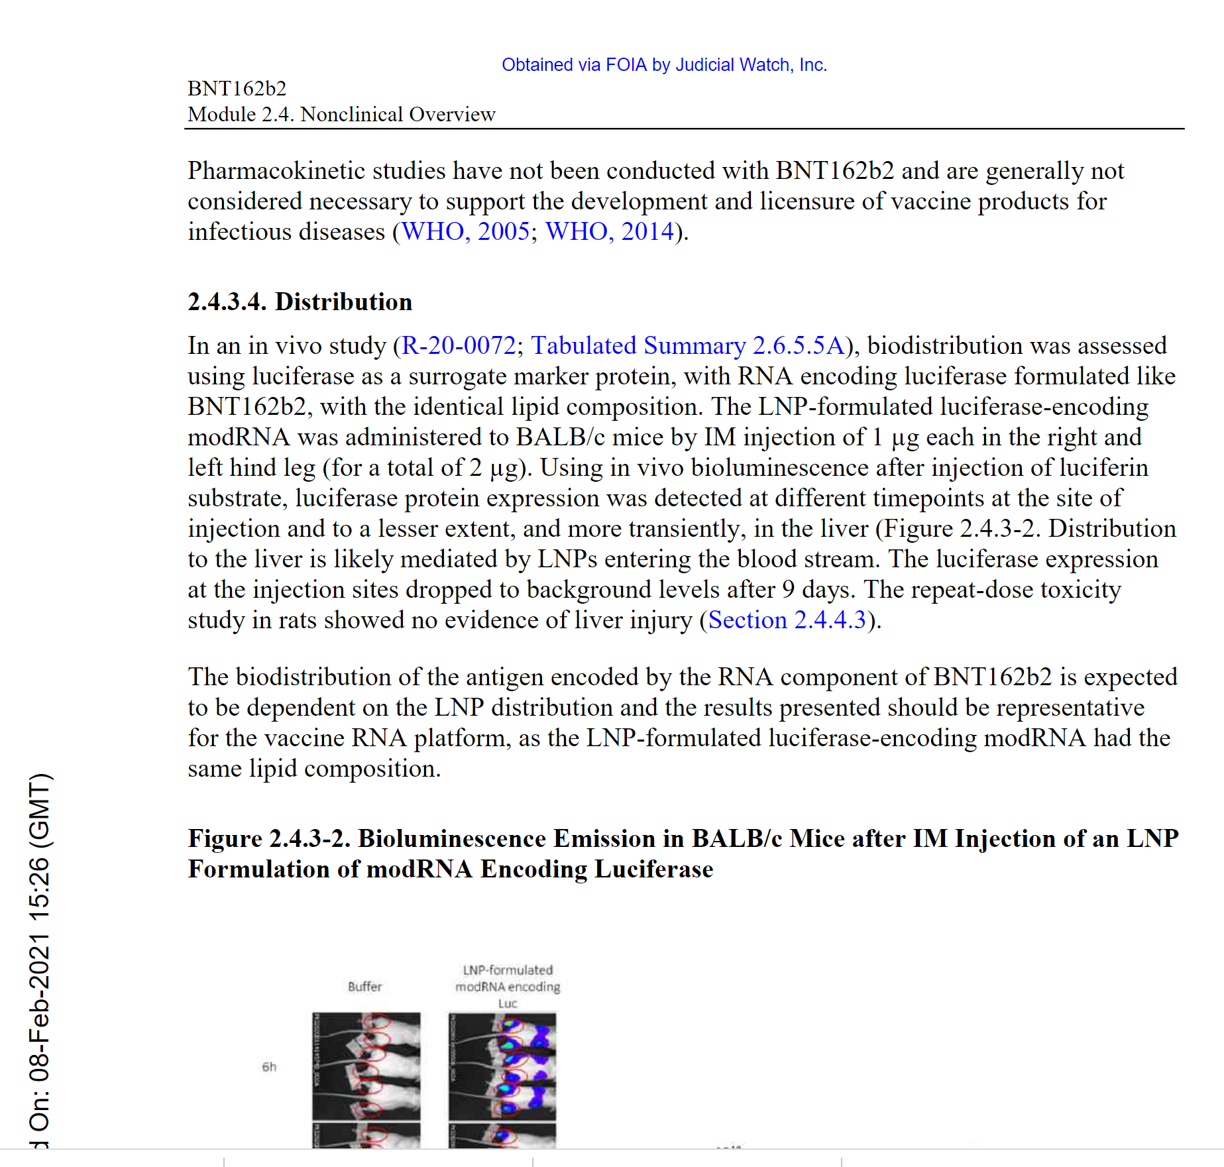
This product does not meet the definition of a vaccine in 2005 or 2014
The injected substance enters blood stream and goes to the liver

Slide 8
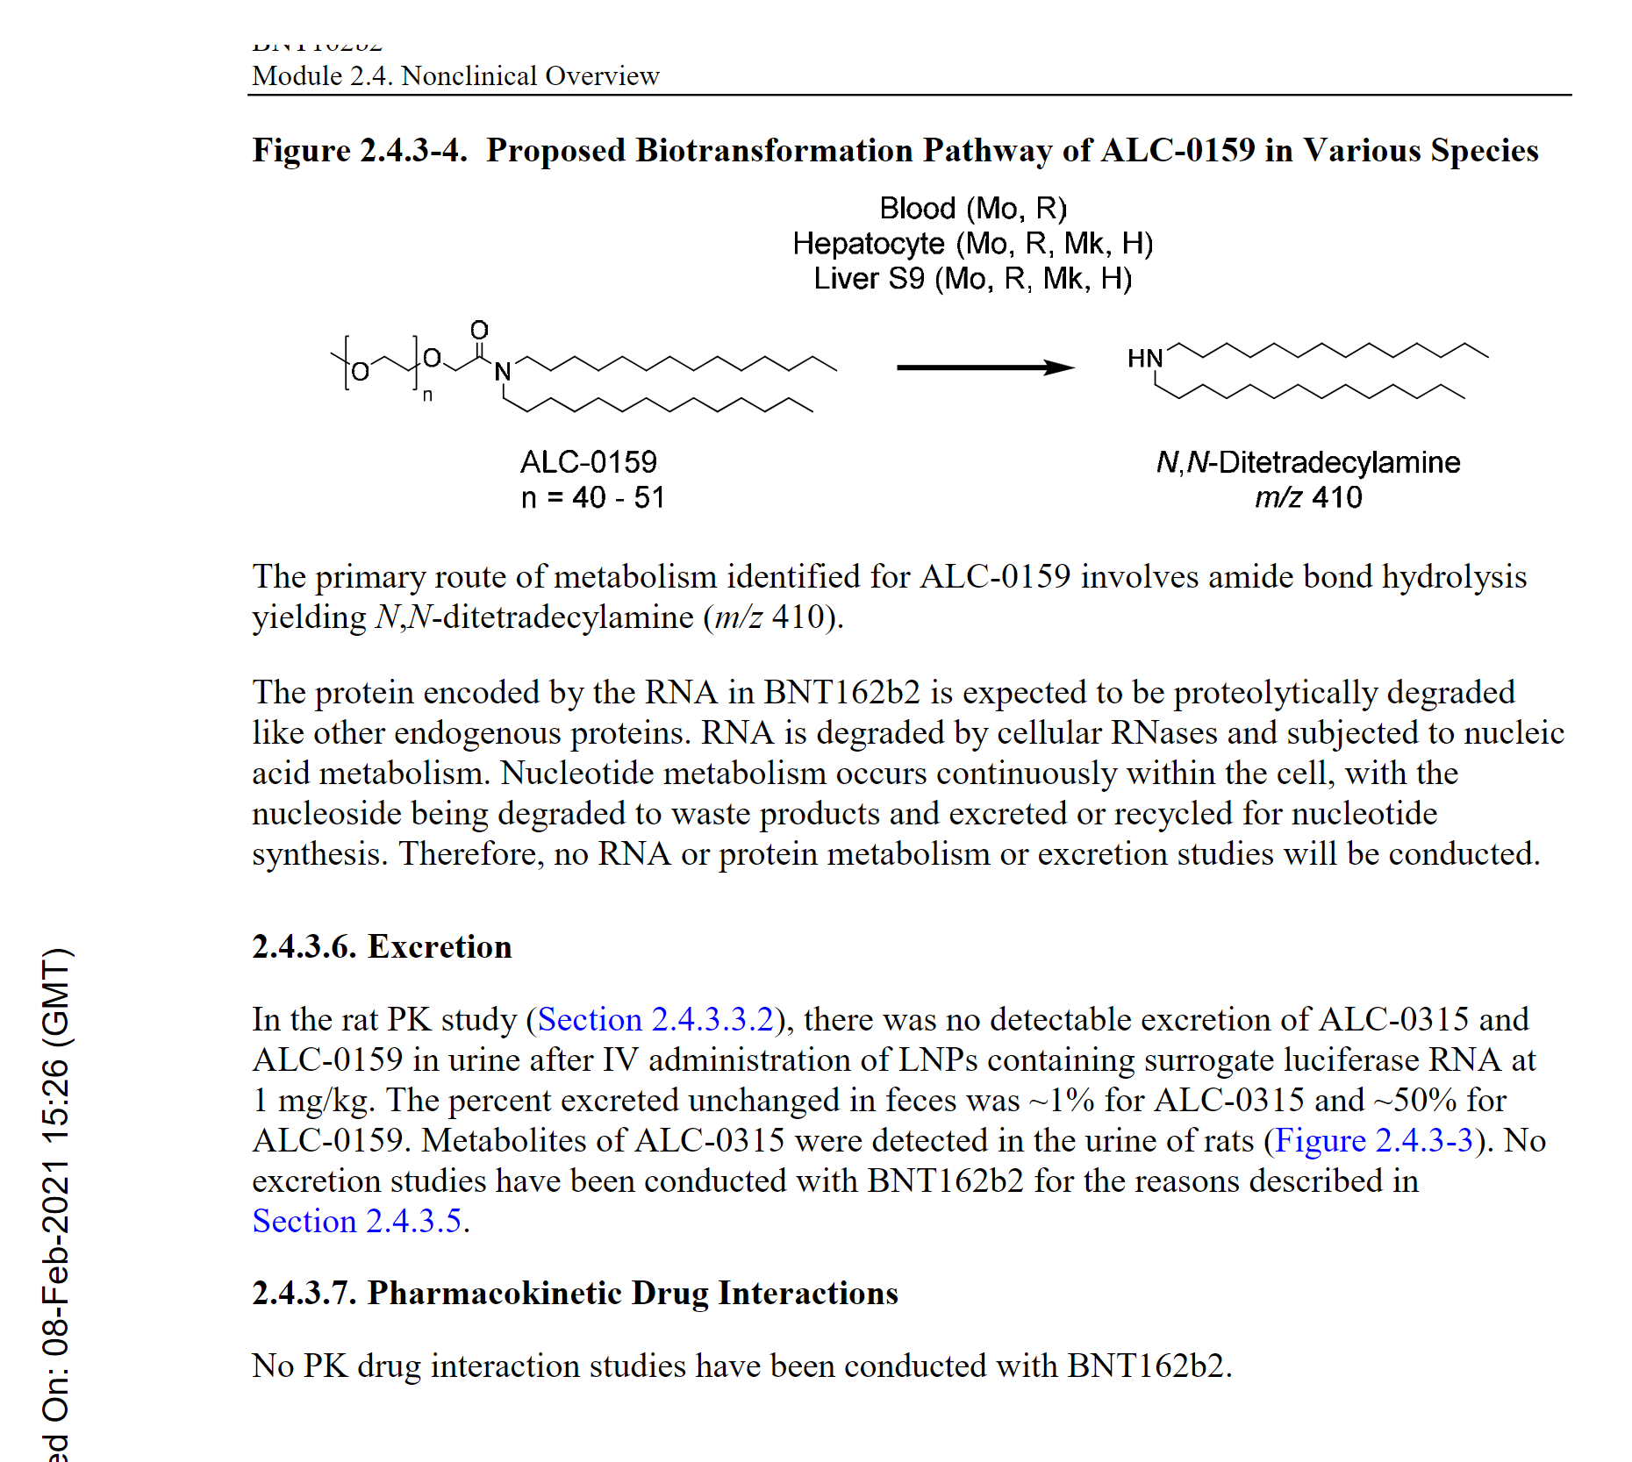
Is this a hypothesis only?
Why was this allowed?

Slide 9
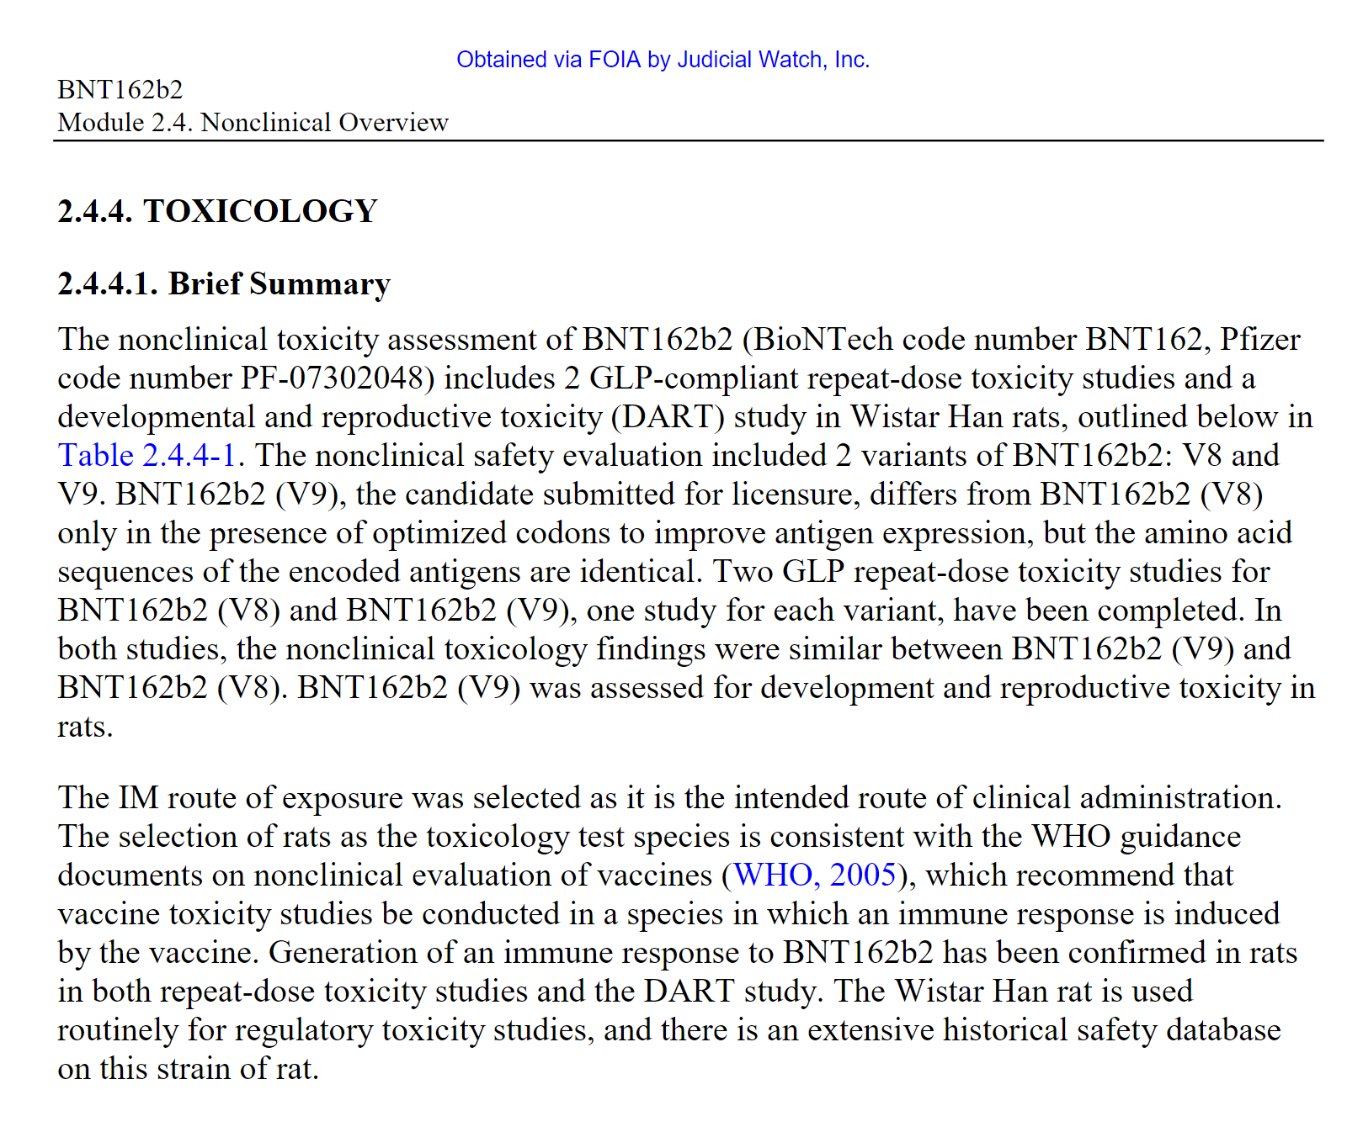
The reproductive tox study in rats was non-GLP compliant, ie not suitable for full FDA approval or for clinical phase of product development - that’s probably why Pfizer’s protocol required contraception for persons of reproductive potential. CDC however advertised this product directly to pregnant women even before the EUA was granted.
2 variants of product (V8 and V9) – none of which are the ultimately “authorized” or licensed product! The V8 is “pretty close” though, so we just have to take Pfizer’s word for it?
Note that the reproductive tox study was done with V9 version, not even “pretty close” to the product that was licensed.
This is fraud, as all studies must be done with exactly the same product that is being reviewed and approved by the FDA.

Slide 10
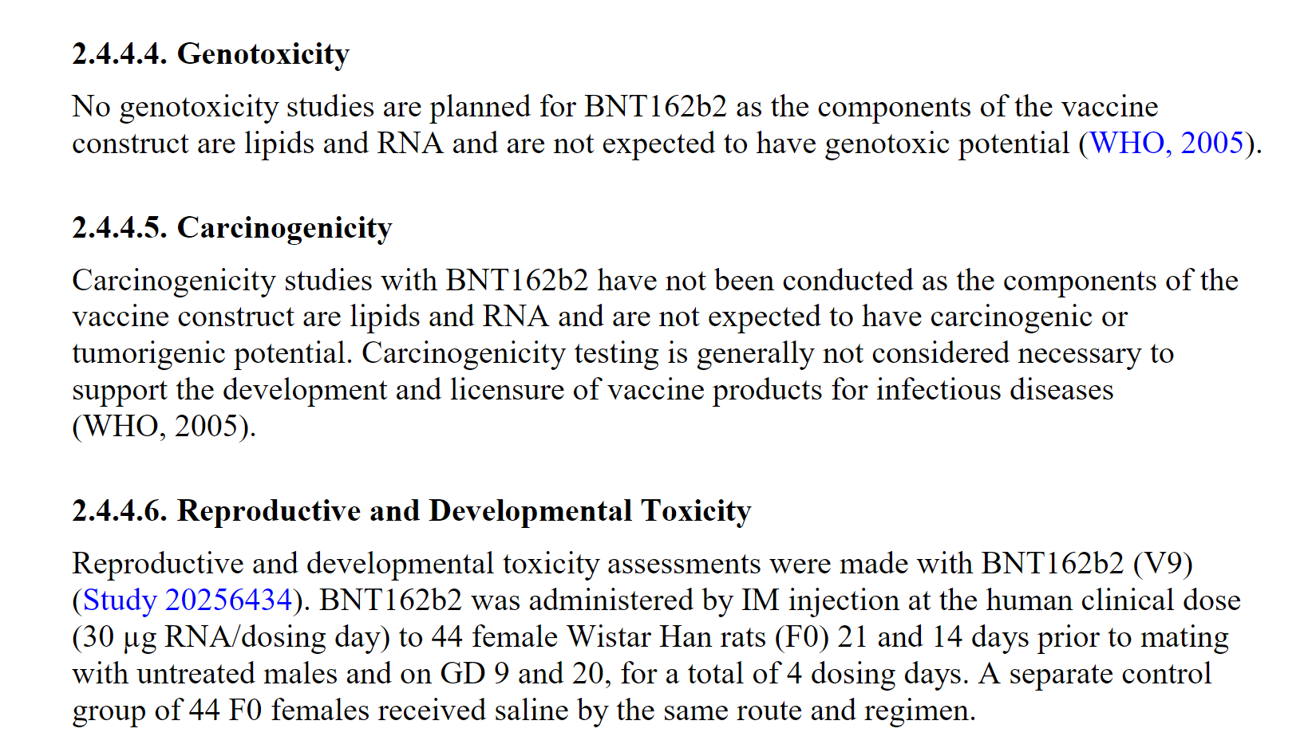
WHO guidelines from 2005 are not applicable to mRNA products which are completely novel technology and did not exist back then. Based on the recent Swedish study it was demonstrated that mRNA does incorporate into DNA via reverse transcription.
See comment on p 9.

