Slide 1
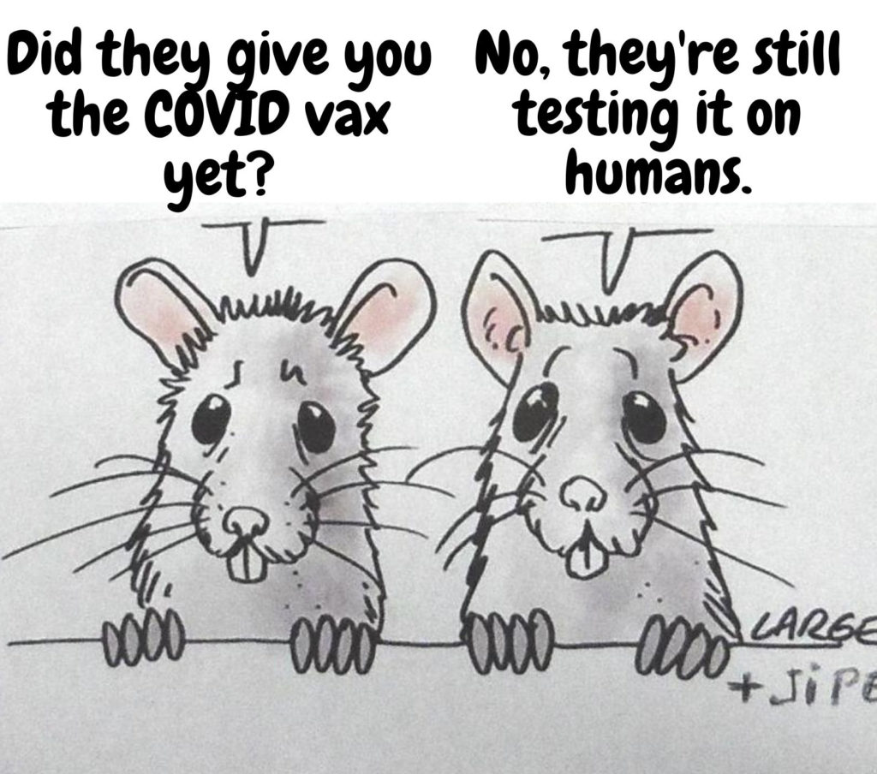
Did Pfizer Do Any Safety Studies?
Pfizer’s Non-Clinical Studies Used for FDA Review and Approval of Comirnaty Injection. Obtained by FOIA, March 2022

Slide 2
FDA and Pfizer Knew All Risks!
FDA Guidance for Gene Therapy Products (June 2015) warns of severe risks with GTs:
  Potential for multi-organ failure
  Potential for tumors/cancer development
  Potential for prolonged uncontrollable activity after single administration
  Immunogenicity as a risk (autoimmunity)
  Uncontrolled expression of genes
  Migration of product to undesired organ systems
  Possibility of shedding: excretion/secretion of viral particles that could be transmitted to other individuals
  Studies in healthy volunteers are not generally advised due to potential severe risks
These products were UNAPPROVABLE by “normal” regulatory process. Crisis was the only way to push them on the market.

Slide 3
Summary of a Typical Non-Clinical Program for a New Drug
Pharmacology
Primary
Secondary
Safety Pharm
Biodistribution
Drug Interactions
Cardiovascular
CNS
Pharmacokinetics
Liver, Renal, Blood, etc
ADME
+
Toxicology
Genotoxicity
Carcinogenicity
Reproductive Tox

Slide 4
What is Pharmacokinetics?
Pharmacokinetics, as a field, studies the movement of drugs/biologics throughout the body and the actions of the body on the drug:
  Where in the body the substance is distributed?
  In what concentrations?
  What is the time course?
  How is it metabolized?
  How is it eliminated?
  How controllable is it (over-/under-exposure)?
  What is the therapeutic range: the lowest limit of therapeutic benefit and the highest limit of exposure that avoids adverse events?
  Justification for dose selection?

Slide 5
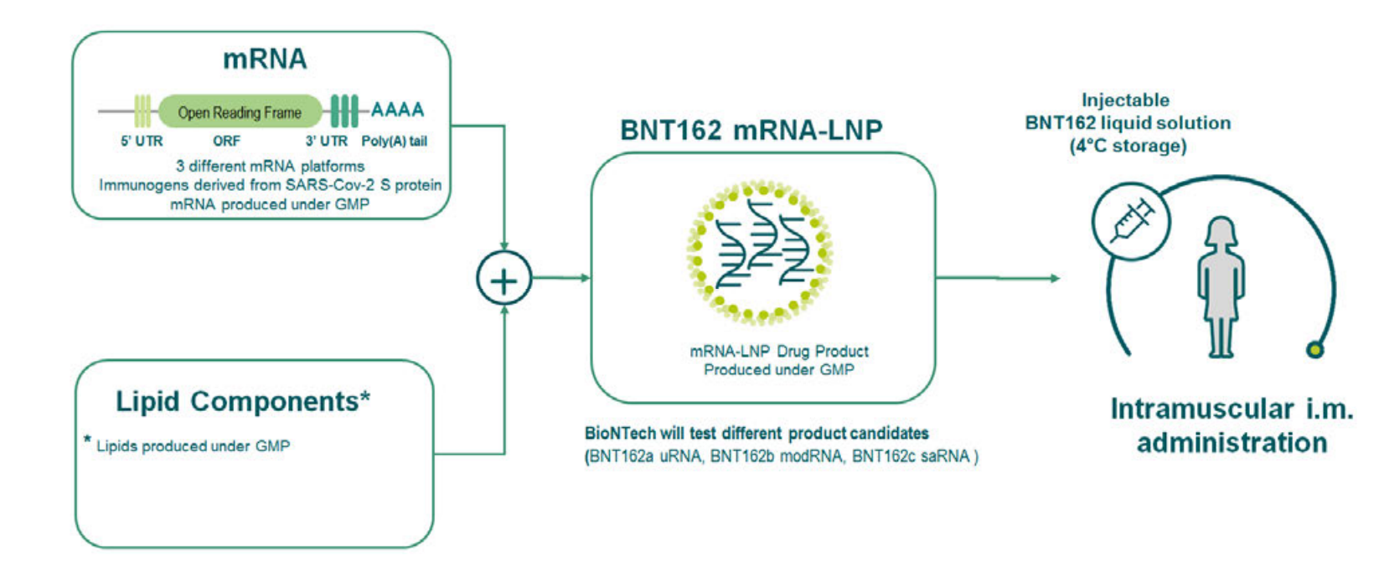
Pfizer conducted pharmacokinetic studies for the nanoparticle delivery lipids ONLY
This part was studied. This is everything we know about these compounds!
Source: BioNTech investigators brochure, Aug 2020

Slide 6
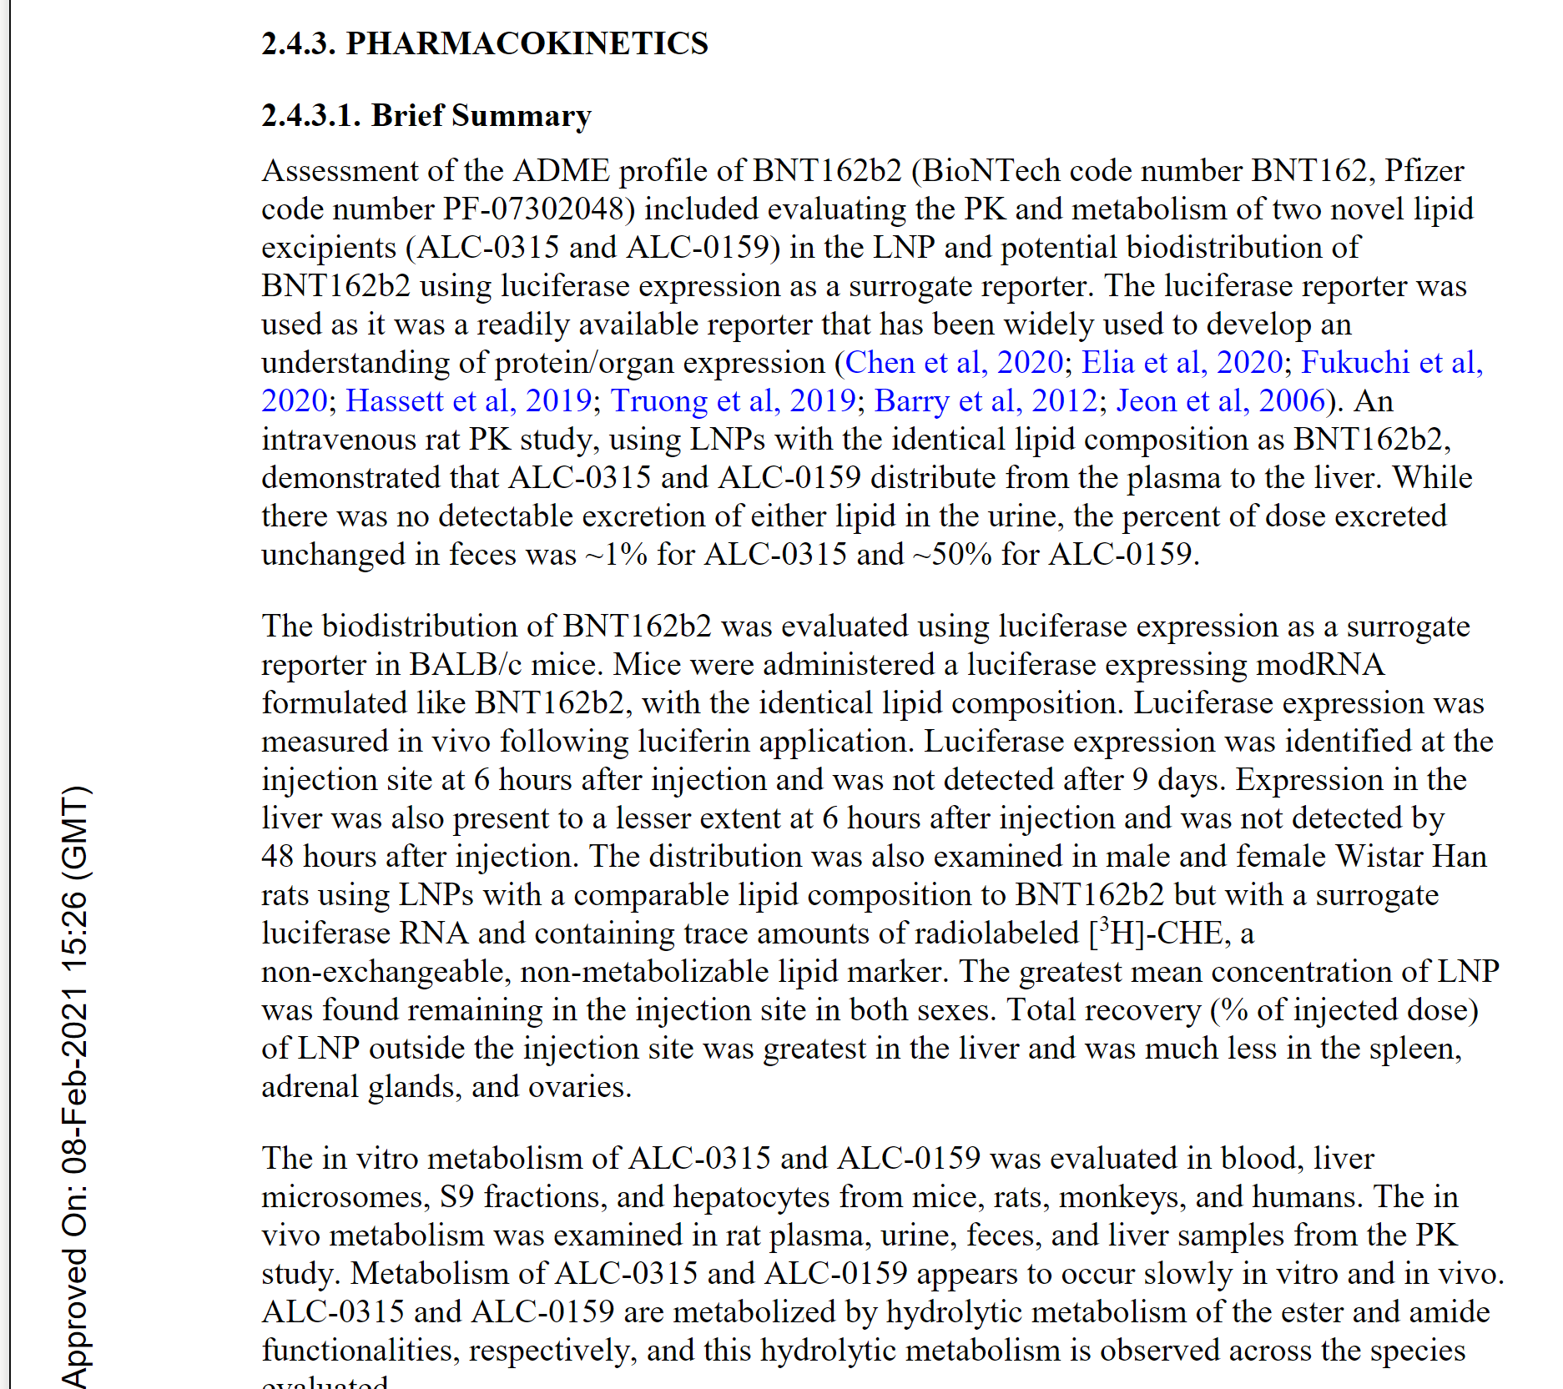
Pfizer, CDC and FDA lied repeatedly about “vaccine staying in the injection site”. The substance is clearly getting distributed into the liver, spleen, ovaries and other organs.
Yet, no safety pharmacology studies were done and therefore we have no knowledge of the safety margins!

Slide 7
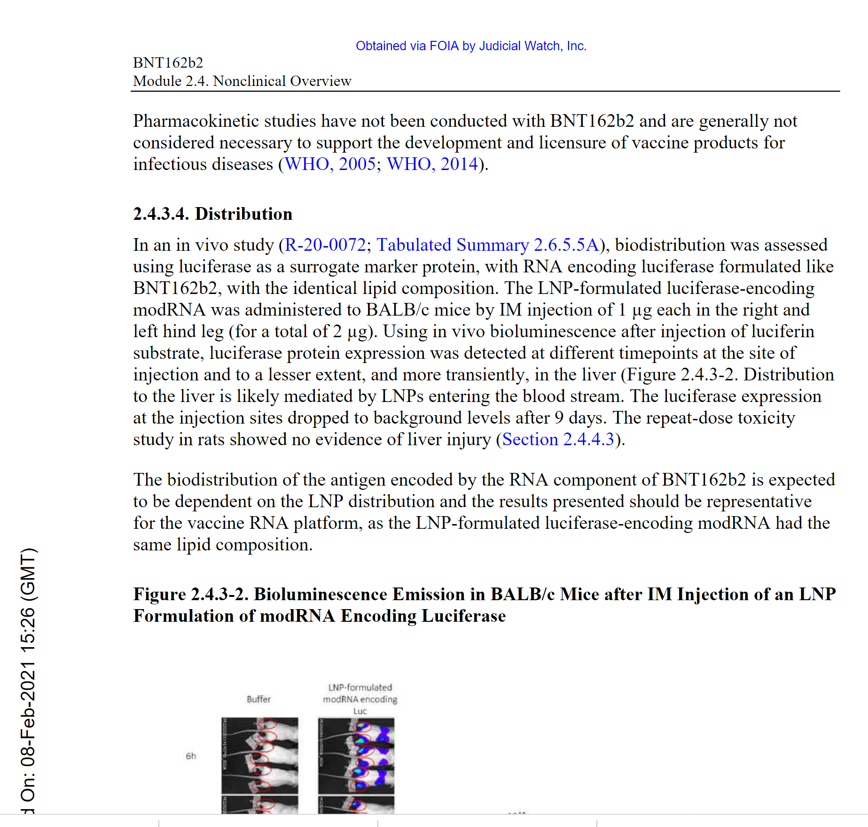




Pharmacokinetics of the Active Ingredient or full product WERE NOT STUDIED
Substituted the active ingredient with an irrelevant one (coding for luciferase, not spike protein) and claim it’s “the same” as mRNA coding for spike!!!
Repeat: NEVER TESTED SPIKE CODING mRNA FOR BIODISTRIBUTION/SAFETY

Slide 8
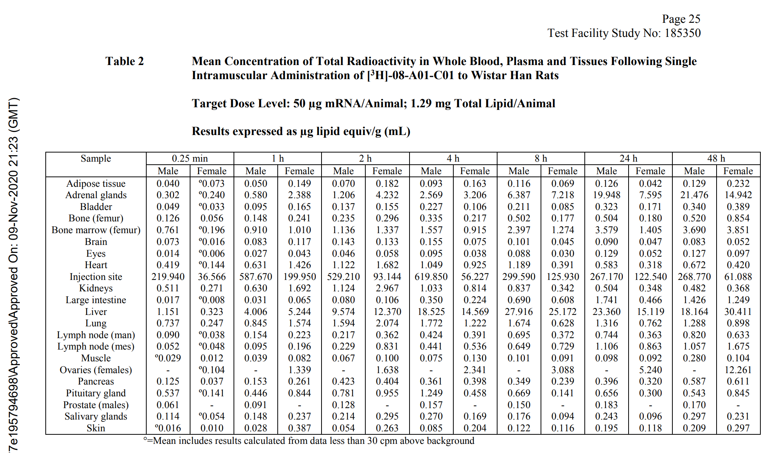
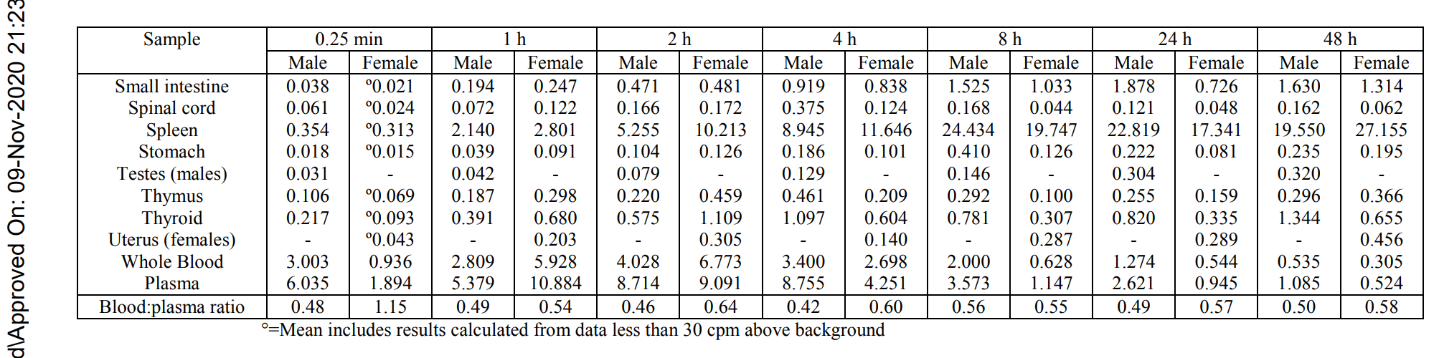
The substance is clearly getting distributed into the adrenal glands, liver, spleen, ovaries, bone marrow. Lymph nodes and all other organs.
Concentration in the liver, spleen and ovaries for females is still increasing when the study is stopped.
Even small amounts of mRNA/spike protein expressed in vital organs can have unknown, possibly catastrophic effects.

Slide 9
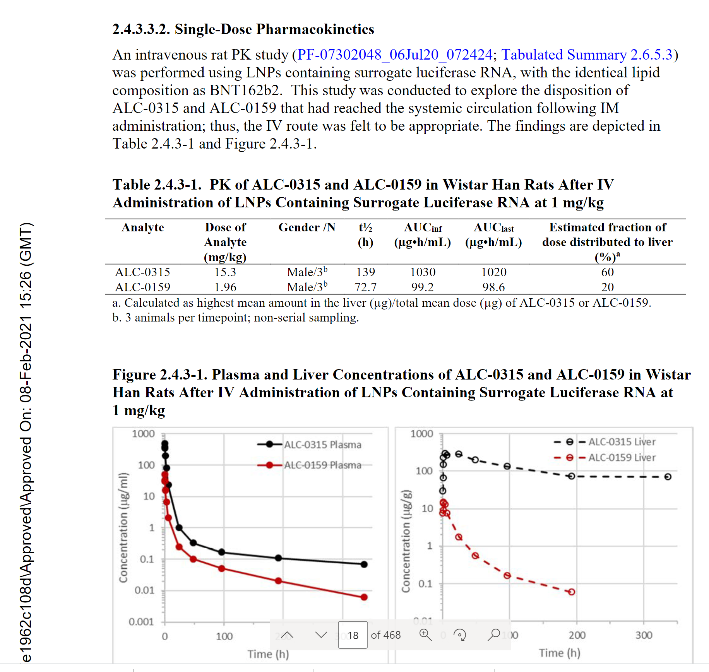
Pfizer was expecting the injections to be reaching blood stream directly.
The excipients are getting to the liver in large quantities, yet there are no safety pharmacology, or any follow up studies on studies of hepatotoxicity!
ALC-0315: no decrease of concentration at 300h after injection. No data on if/when it was cleared from liver.

Slide 10
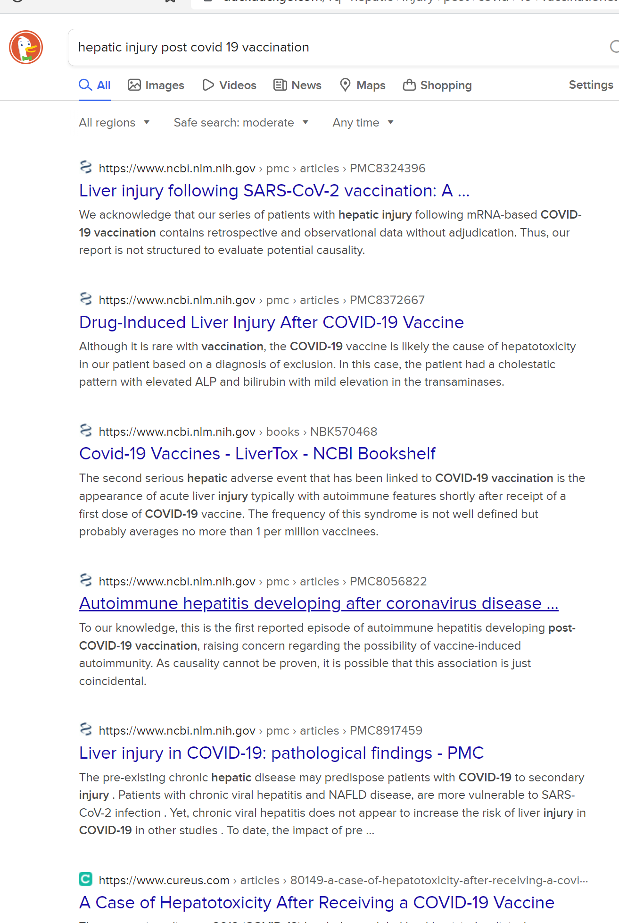
Liver Injury with Cov19 Injections: Numerous reports and published studies

Slide 11
Summary of PK for PfizerC19 Injection:
Pfizer chose to study PK/distribution for lipid delivery vehicle only:
  Not all studies contained the same formulations of lipids
  Did not study how the spike protein would be distributed and expressed, and what toxicities it might cause
  Did not fully characterize time course of distribution, esp. for females
  Demonstrated high concentrations of lipid nanoparticles (which would be carrying mRNA and expressing toxic spike protein in major organs) and then chose not to study it any further.
Regulators did not question any of this!

Slide 12
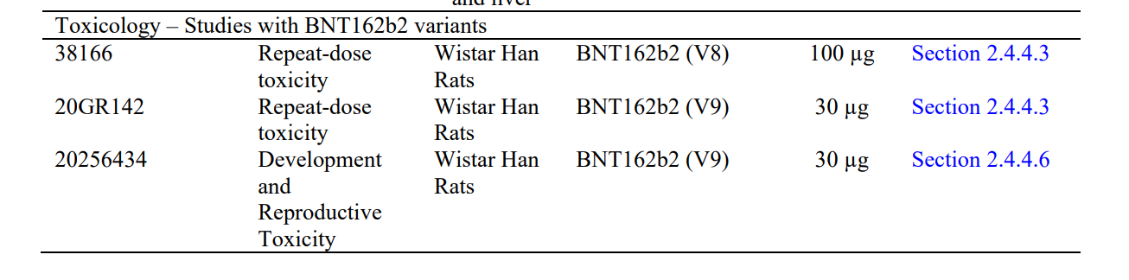
Toxicology: Study of harmful effects of substances
Different version of product
Non-GLP study
Only 1 study was done for the “correct” version and in a validated setting, let’s review…

Slide 13
Pfizer Claims “No Systemic Effects” in a Rat Toxicity Study
20% decrease in food consumption, and increase in body temperature (fever), weight loss
Clinical pathology changes consistent with inflammation
Increase in lab parameters, still increasing at the time the study was stopped!
  3X WBC, 7X neutrophils, 3X monocytes, 13X LUC
  2.5X Fibrinogen, 39X alpha1-acid Glycoprotein, 71X alpha2 Macroglobulin
Increase in spleen weight 1.5X
Enlarged draining lymph nodes (not recovered at the end of study)
Pathology findings in lymph nodes, liver, spleen, bone marrow noted and ignored
Pfizer waived all of this off as “immune system is reacting, and it will be ok”.

Slide 14
What is Safety Pharmacology?
Safety pharmacology investigates potential undesirable pharmacodynamic effects of new medicines on physiological functions in relation to exposure in the therapeutic range and above.
Primary organ systems (so-called core battery systems) are:
  Central Nervous System
  Cardiovascular System
  Respiratory System
Secondary organ systems of interest are:
  Gastrointestinal System
  Renal System
  Other systems if exposure detected/known
Safety pharmacology studies are required to be completed prior to human exposure (i.e., Phase I clinical trials), and regulatory guidance is provided in ICH S7A and other documents.
Safety pharmacology studies are required for all components of the new pharmaceutical product. They are particularly critical for the novel proprietary and undisclosed excipients used by Pfizer – ALC-0315 and ALC-0159.

Slide 15
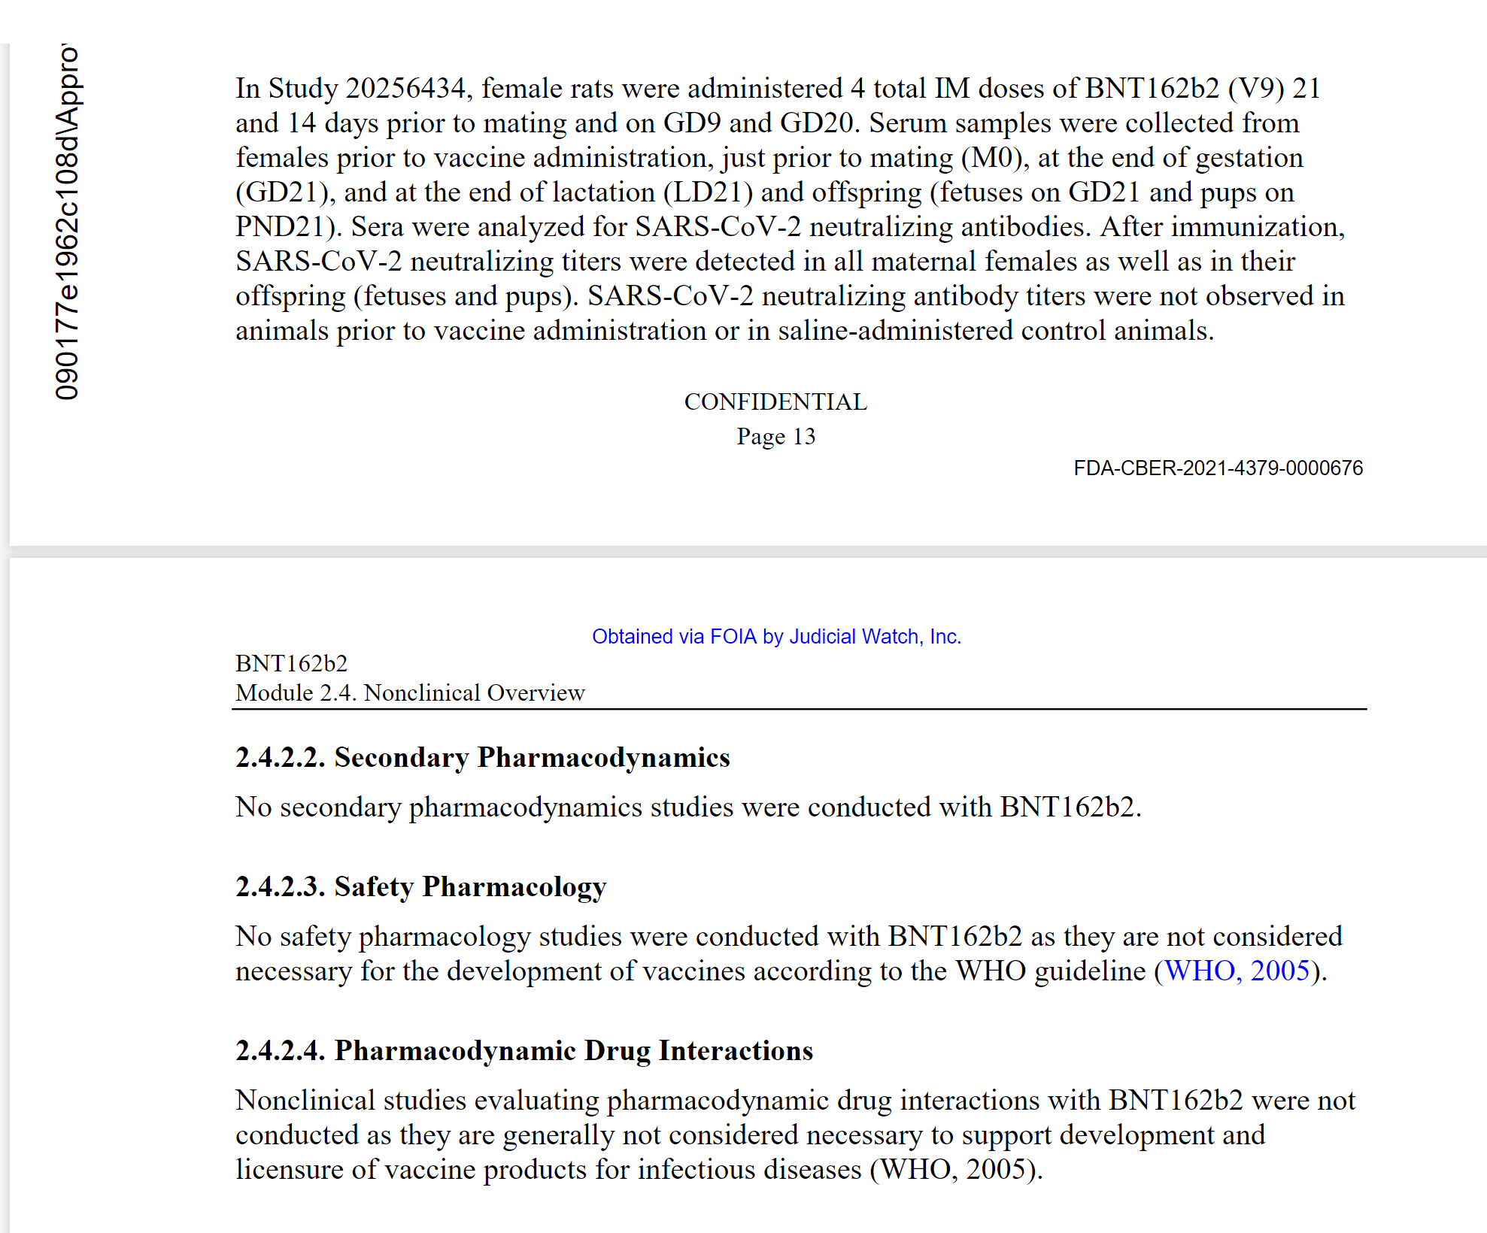
mRNA injections do not meet the WHO 2005 definition of the vaccine.
The more novel the technology the more stringent safety evaluation should be used (and were historically required by the FDA).
FDA approves medicines in the US, not WHO. Yet, FDA did not push back on this nonsense claim.

Slide 16
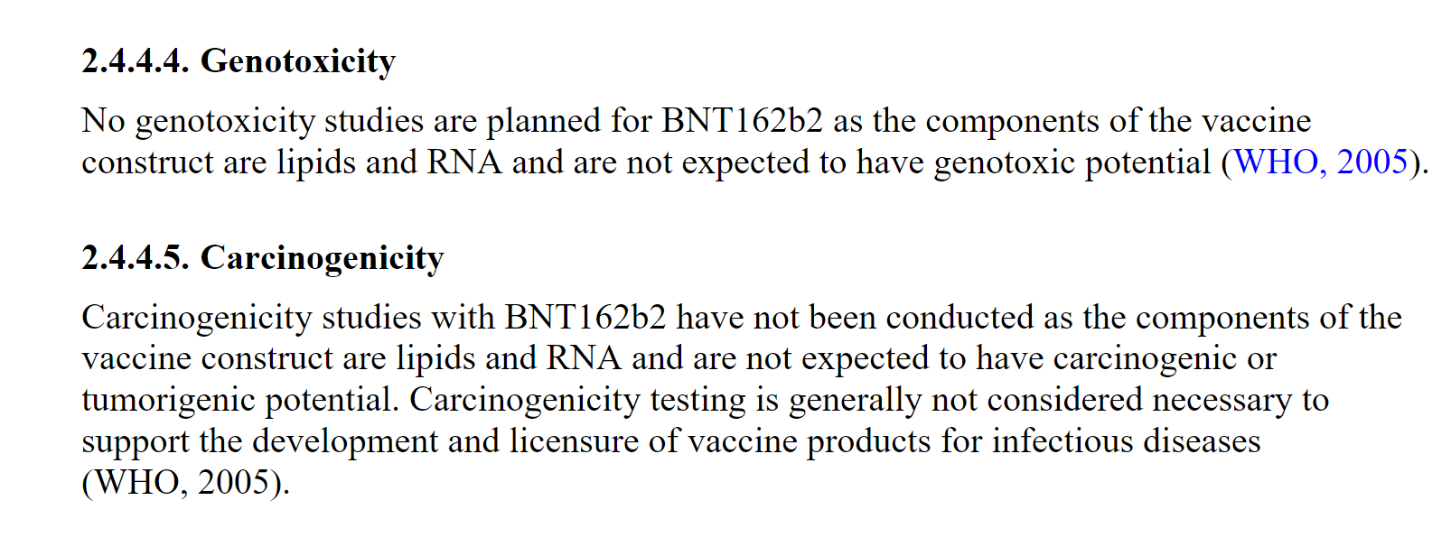
Pfizer declared Genotoxicity and Carcinogenicity as not applicable based on WHO Guidelines
Based on the recent study* it was demonstrated that mRNA does incorporate into DNA via reverse transcription.
*Intracellular Reverse Transcription of Pfizer BioNTech COVID-19 mRNA Vaccine BNT162b2 In Vitro in Human Liver Cell Line
Markus Aldén et al, Department of Clinical Sciences, Lund University, 20502 Malmö, Sweden

Slide 17



What do WHO Guidelines from 2005 say?
4.2.4 Safety pharmacology The purpose of safety pharmacology is to investigate the effects of the candidate vaccine on vital functions. If data from nonclinical and/or human clinical studies suggest that the vaccine (e.g. one based on specific toxoids) may affect physiological functions (e.g. central nervous system, respiratory, cardiovascular and renal functions) other than those of the immune system, safety pharmacology studies should be incorporated into the toxicity assessment. Useful information on this topic can be found in the Note for Guidance on safety pharmacology studies for human pharmaceuticals.
© World Health Organization WHO Technical Report Series, No. 927, 2005. Annex 1 WHO guidelines on nonclinical evaluation of vaccines

Slide 18

What do WHO Guidelines say (cont)?
4.2.3 Genotoxicity and carcinogenicity studies Genotoxicity studies are normally not needed for the final vaccine formulation. However, they may be required for particular vaccine components such as novel adjuvants and additives. If needed, the in vitro tests for mutations and chromosomal damage should be done prior to first human exposure. The full battery of tests for genotoxicity may be performed in parallel with clinical trials.
Carcinogenicity studies are not required for vaccine antigens. However, they may be required for particular vaccine components such as novel adjuvants and additives.
These studies are required for novel products. At a minimum, they are required for novel, proprietary and undisclosed excipients ALC-0315 and ALC-0159.

Slide 19
Pfizer collected NO cardiovascular safety data in Preclinical Studies
“Cardiovascular” is not mentioned in the entire package, even once (450 pages).
“Cardiac” mentioned 2 times when describing sampling tissues in rat studies. No assessment of impact on any cardiac function was done.
Pfizer have not done (or not reported) any information about possible impact on cardiac function and simply told the FDA that cardiovascular safety evaluations do not apply to their product.
Absence of evidence is not evidence of absence!

Slide 20
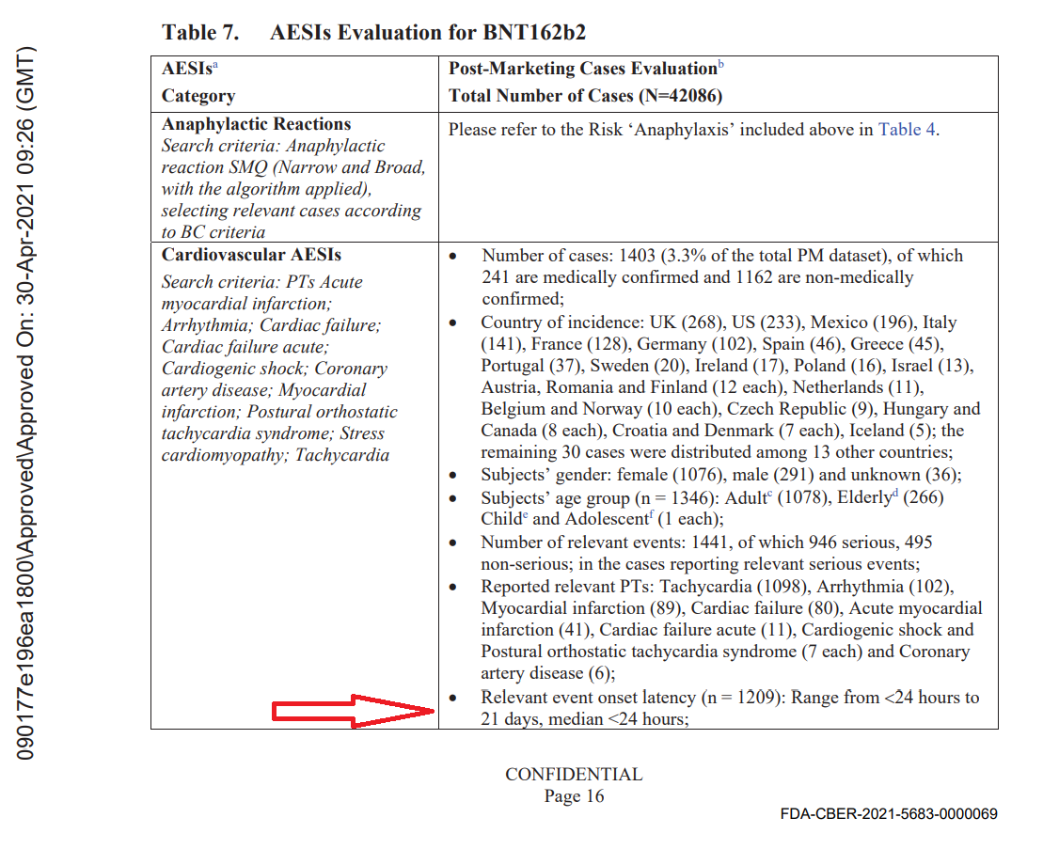
Cardiovascular deaths have exploded right after the mass vaccination rollout (2 months of data, Feb 2021)
From Pfizer’s Own Pharmacovigilance Report

Slide 21

Summary of Pfizer’s Non-Existing Non-Clinical Testing Program
Pharmacology
Immunogenicity
Monkey study without covid illness
Primary
Secondary
Safety Pharm
Did not study spike protein distribution in vivo at all!
Replaced with a “surrogate”
Drug Interactions
Cardiovascular
Biodistribution
CNS
Liver, Renal, Blood, etc
ADME
Toxicology
Genotoxicity
Distribution studies of LNP show the substance reaching all organs (and will get spike protein expression there)
Only 1 relevant study in 20 rats!
Carcinogenicity
Reproductive Tox*
* Study not in compliance with Good Laboratory Practices, not acceptable for approval/labeling

